Slide 1
SubZero Lineage APIs for Scientific Databases
eugene wu, samuel madden, michael stonebraker

Slide 2

SubZero Lineage APIs for Scientific Databases
eugene wu, samuel madden, michael stonebraker
http://bbsimg.ngfiles.com/1/21544000/ngbbs4c52149d38558.gif
Notes:
Will walk through on an application that uses lineage, and point out issues along the way

Slide 3
Lineage APIs for Scientific Databases
Multi-dimensional array
Array
Notes:
Talking about arrays, not tables and records anymore. All cells have an identifier – the indexing into the array, and locality has meaning.

Slide 4
Considerations
User defined operators
Lots of data, limited storage
What kind of lineage to store?
How to store the lineage?

Slide 5
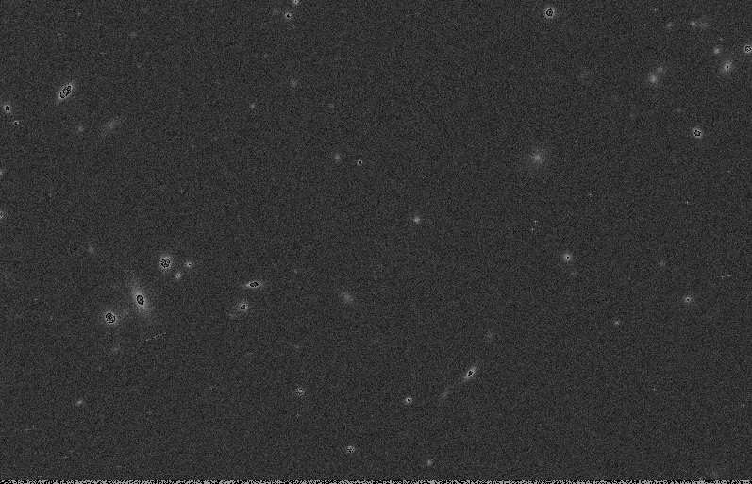
Notes:
The easiest way to introduce this talk is to directly plunge into the dark recesses of the universe.
What are we doing here? Why does brisbane exist? These are the questions that

Slide 6
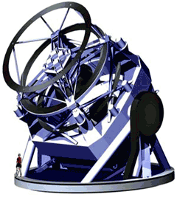
LSST
Notes:
Large Synoptic Survey Telescope – largest ground telescope, initially planned to open in 2015.
High level –very expersive camera take pictures of the sky across a large light spectrum, to detect stars and moving objecs

Slide 7
LSST
Notes:
Since the sky is very large, it move across the sky at night and takes photographs of small chunks of the sky

Slide 8

LSST Pipeline
Raw Image
Detect Stars
Stars
Notes:
At a broad stroke, one of their necessary pipelinesis their start detection process, which
takes the raw images, stored as arrays, taken by the telescope,
runs star detection algorithms on the pixels, and
generates tuples where a tuples represents a star.

Slide 9
LSST Pipeline
Raw Image
Detect Stars
Stars
Notes:
Of course it’s not as simple as that….

Slide 10
LSST Pipeline
Convolve
Mean background
rm –rf background
Apply Mask
Interpolate
Remove Cosmic Rays
And more ....
Raw Image
Detect Stars
Stars
Notes:
There are a huge number of steps even in a simplified pipeline –
First need to deconvolve the image to remove atmospheric and lens distortions
Remove background noise
Delet crazy pixels
Interpolate
Et…

Slide 11
LSST Pipeline
C
D
A
B
Database Operator
User Defined Operator
Notes:
Don’’t worry about it, except to note that the blue, solid boxes are database native operators, whereas the red dashed boxes are user define operators for cosmic ray detection.

Slide 12
Considerations
User defined operators
Lots of data, limited storage
What kind of lineage to store?
How to store the lineage?
Notes:
This pipeline highlights the fact that we need to support UDFs

Slide 13
LSST Data Scale
C
D
A
B
Notes:
This pipeline doesn’t run on just one image

Slide 14
LSST Data Scale
>360,000
Images/night
Notes:
But over 300k images a night

Slide 15
LSST Data Scale
10M+
Images/month
Notes:
And over 10Million per month. Imagine two months from now,

Slide 16
What kind of lineage queries?
Coarse
Fine
grained
Notes:
The types of lineage queries you want to run.
They largely fall into corase and fine grained lineage

Slide 17
What kind of lineage queries?
Coarse
Fine
grained
Backward
Which image
is this star from?
Notes:
They are backward – what file or image is this star from

Slide 18
What kind of lineage queries?
Coarse
Fine
grained
Backward
Forward
Which image
is this star from?
What stars are
from this image?
Notes:
Or forward queries which want to know objcects generate from an input file or array

Slide 19
What information to store?
Coarse
Fine
grained
input
output
1 Pair
Notes:
If we consider input and output arrays, and suppose the orange cells in the input affected the orange cells in the output, it doesn’t matter!
we only need to store one edge between input and outputs at the file or array level.
This has traditionally been well served by the community,
we are not interested in this explicitly.

Slide 20
What kind of lineage queries?
Coarse
Fine
grained
Notes:
Fine grained is a different beast entirely

Slide 21
What kind of lineage queries?
Coarse
Fine
grained
Backward
Which pixels
is this star from?

Slide 22

What kind of lineage queries?
Coarse
Fine
grained
Backward
Forward
Which pixels
is this star from?
What pixels in
step X affected?
Notes:
Similarly, in a forward query. The astronomer knows only this jagged portion of the image is unreliable, so what pixels in the pipeline were affected?

Slide 23
What information to store?
Coarse
Fine
grained
input
output

Slide 24
What information to store?
Coarse
Fine
grained
input
output

Slide 25
What information to store?
Coarse
Fine
grained
input
output
O(N²) Pairs
N = # array cells
Notes:
This is the problem to solve!
Clearly, what we store depends on the types of queries we are executing

Slide 26
Considerations
User defined operators
Lots of data, limited storage
What kind of lineage to generate?
How to store the lineage?
Notes:
Tons of data, but LSST only wants to devote absolutely no more than 20% to provenance and ideally as little as possible. Willing to put effort.

Slide 27
Coarse-grained
Slower lineage queries
Minimal storage
Notes:
One trick we can play, assuming we can tell an operator to spit out lineage information at any time, and reliably re-run operators, is to
only store coarse grained information, which is cheap, and
when a user runs a lineage query, just rerun the operators with the orginal inputs.
The other is to store only fine-grained lineag..

Slide 28
Coarse-grained
Fine-grained
Slower lineage queries
Minimal storage
Faster lineage queries
Takes too much space!
Notes:
One trick we can play, assuming we can tell an operator to spit out lineage information at any time, and reliably re-run operators, is to
only store coarse grained information, which is cheap, and
when a user runs a lineage query, just rerun the operators with the orginal inputs.
The other is to store only fine-grained lineag..

Slide 29
Coarse-grained
Fine-grained
Slower lineage queries
Minimal storage
Faster lineage queries
Takes too much space!
Notes:
These are clearly two extreme approaches.

Slide 30
SubZero
Spectrum of hybrids
Coarse-grained
Fine-grained
Slower lineage queries
Minimal storage
Faster lineage queries
Takes too much space!
Notes:
And subzero is interested in the spectrum of hybrid solutions.

Slide 31
Considerations
User defined operators
Lots of data, limited storage
What kind of lineage to generate?
How to store the lineage?
Notes:
This suggests that we need to consider what kind of lineage to generate

Slide 32
Considerations
User defined operators
Lots of data, limited storage
What kind of lineage to generate?
How to store the lineage?
Notes:
And of course how to represent and store the lineage.
These are the points Subzero tries to address

Slide 33
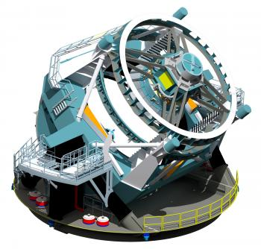
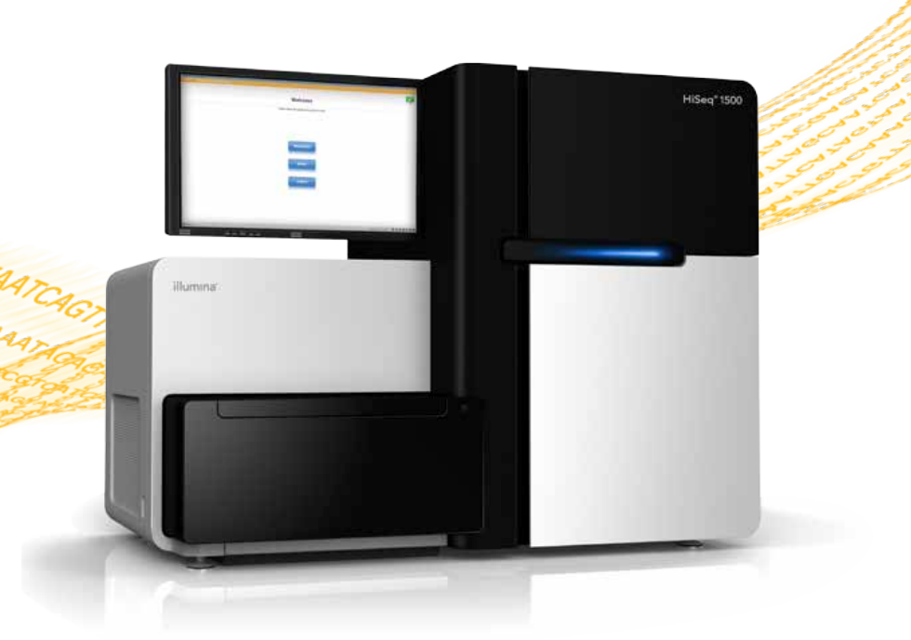
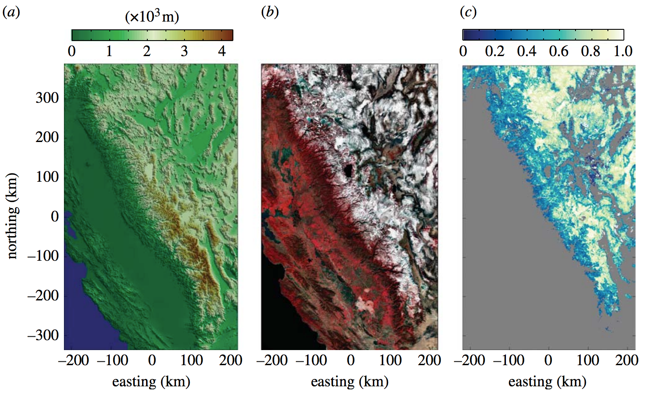
Considerations
User defined operators
Lots of data, limited storage
What kind of lineage to generate?
How to store the lineage?
Astronomy
Environmental Science
Genomics
Computational provenance in hydrologic science: a snow mapping example
https://news.slac.stanford.edu/features/nsf-large-synoptic-survey-telescope-approved-advance-final-design-stage.
http://www.illumina.com/systems/hiseq_2500_1500.ilmn
Notes:
Of coruse. This model does’nt just apply to astronomy – applies to

Slide 34

SubZero
Goal
Insights
Efficiently store & query lineage
Small # ways to encode lineage
Lineage API for UDFs
Query-driven storage optimizer
http://images2.fanpop.com/image/photos/10600000/sub-zero-mortal-kombat-10603273-66-137.gif
Notes:
The goal is to introduce the main concepts from the paper, so presenting highly simplified version of the ideas. See papers for the gory details

Slide 35
SubZero
Workflow
+
Data store
Workflow Engine
A
D
C
Runtime
Data Store
Notes:
Subzero’s architecture revolves around a workflow engine coupled with a data store

Slide 36
SubZero
Array
Arrays are processed and stored
Workflow Engine
A
D
C
Runtime
Data Store
Notes:
During normal workflow execution, arrays enter the workfow, are processed, and results are stored

Slide 37
SubZero
Array
Operators instrumented to generate lineage
Workflow Engine
A
D
C
Runtime
Data Store

Slide 38
SubZero
Array
Lineage written to runtime layer
Runtime encodes lineage
Workflow Engine
A
D
C
Runtime
Encoder/decoder
Data Store

Slide 39
SubZero
Array
Queries
Cells
Lineage query executor accesses the runtime
May re-run operators
Workflow Engine
Lineage
Query Executor
A
D
C
Runtime
Encoder/decoder
Re-executor
Data Store

Slide 40
SubZero
Array
Constraints
Queries
Cells
Optimizer decides what lineage runtime will store
Workflow Engine
Optimizer
Lineage
Query Executor
A
D
C
Runtime
Encoder/decoder
Re-executor
Data Store

Slide 41
Representing Lineage Exposing Operator Lineage What lineage to store? Does this work? Misc…

Slide 42
Focus Fine-grained backward lineage
Notes:
The paper talks about forward lineage and combining both. For ease of explanation, I’ll focus on backward lineage in this talk.

Slide 43


Convolution
USE STAR DETECTION INSTEAD
input
output
http://archive.org/details/Lectures_on_Image_Processing

Slide 44
Convolution
input
output
http://archive.org/details/Lectures_on_Image_Processing

Slide 45
Convolution
input
output
http://archive.org/details/Lectures_on_Image_Processing

Slide 46
Convolution
Backward Lineage
input
output
http://archive.org/details/Lectures_on_Image_Processing

Slide 47
Naïve Representation
1 | 2
3 | 4
1 | 2
3 | 4
input
output
Individual cell to cell
1 ← 1
2 ← 1
Notes:
Note the arrows.
Define relationship in terms of individual items (cells)

Slide 48
Naïve Representation
O(N²)
1 | 2
3 | 4
1 | 2
3 | 4
input
output
Individual cell to cell
1 ← 1
2 ← 1
Notes:
Note the arrows.
Define relationship in terms of individual items (cells)

Slide 49
Region Pairs
1 | 2
3 | 4
1 | 2
3 | 4
input
output
Set of cells to Set of cells
{1,2} ← {1}
Notes:
Relationships between sets of cells (items)
We only store each set of cells once, however

Slide 50
Convolution
output
http://archive.org/details/Lectures_on_Image_Processing

Slide 51
Convolution
output
http://archive.org/details/Lectures_on_Image_Processing

Slide 52
Convolution
output
http://archive.org/details/Lectures_on_Image_Processing

Slide 53
Convolution
output
http://archive.org/details/Lectures_on_Image_Processing
Notes:
So the take away is, even with region pairs, it can be really expensive to create and store all of them. We have four mechanisms to efficiently describe them, based out what we’ve seen from talking to scientists.

Slide 54
Describing Region Lineage
Full
Map
Payload
Composite
input
output
Store input and output cells
{ } ← { }
Notes:
It’s cool, but not so good

Slide 55
Describing Region Lineage
Full
Map
Payload
Composite
 |  | X
Map_{b}(•)
input
output

Slide 56
Describing Region Lineage
Full
Map
Payload
Composite
 |  | X
Map_{b}(•)
input
output
← Map_{b}( )
X
Fully computed.
Nothing to store!

Slide 57
Describing Region Lineage
Full
Map
Payload
Composite
Notes:
Some local knowledge is all that is necessary to know what the input lineage is.
Convolution is a good example. Assuming a uniform convolution matrix, all we need to know is the radius of the pixel neighborhood

Slide 58
Describing Region Lineage
Full
Map
Payload
Composite
Map(•, 1)
input
output
Map(•, 0)
input
output
Notes:
Some local knowledge is all that is necessary to know what the input lineage is.
Convolution is a good example. Assuming a uniform convolution matrix, all we need to know is the radius of the pixel neighborhood

Slide 59
Describing Region Lineage
Full
Map
Payload
Composite
 |  | X
Map_{p}(•, payload)
input
output
Notes:
How to specify that map_p needs to be defined and [coords]+payload need to be stored?
Note that payload is general enough to include existing models of provenance storage.
e.g., trio stores predicates, which can be encapsulated in the payload

Slide 60
Describing Region Lineage
Full
Map
Payload
Composite
 |  | X
Map_{p}(•, payload)
input
output
← Map_{p}( , payload)
X
{ , payload }
X
Notes:
How to specify that map_p needs to be defined and [coords]+payload need to be stored?
Note that payload is general enough to include existing models of provenance storage.
e.g., trio stores predicates, which can be encapsulated in the payload

Slide 61
Describing Region Lineage
Full
Map
Payload
Composite
 |  | X
Map_{p}(•, 1 )
input
output
← Map_{p}( , 1 )
X
{ , 1 }
X
Notes:
How to specify that map_p needs to be defined and [coords]+payload need to be stored?
Note that payload is general enough to include existing models of provenance storage.
e.g., trio stores predicates, which can be encapsulated in the payload

Slide 62
Describing Region Lineage
Full
Map
Payload
Composite
Notes:
How to specify that map_p needs to be defined and [coords]+payload need to be stored?

Slide 63
Describing Region Lineage
1 to 1
Full
Map
Payload
Composite
input
output
Map
Notes:
How to specify that map_p needs to be defined and [coords]+payload need to be stored?

Slide 64
Describing Region Lineage
Full
Map
Payload
Composite
1 to 1
input
output
Map
Notes:
How to specify that map_p needs to be defined and [coords]+payload need to be stored?

Slide 65
Describing Region Lineage
Full
Map
Payload
Composite
1 to 1
input
output
Map
Notes:
How to specify that map_p needs to be defined and [coords]+payload need to be stored?

Slide 66
Describing Region Lineage
Full
Map
Payload
Composite
 |  | x
Payload
input
output
Payload
{ , payload }
x
Notes:
How to specify that map_p needs to be defined and [coords]+payload need to be stored?

Slide 67
Describing Region Lineage
1 to 1
Full
Map
Payload
Composite
 |  | x
Payload
input
output
Map
+
Payload
{ , payload }
x
Notes:
We found that these four descriptions of region pairs were sufficient for the scient applications we encountered.

Slide 68
Representing Lineage Exposing Operator Lineage What lineage to store? Does this work? Misc…
Notes:
We develop General mechanism for UDFs, we use it for native operators as well

Slide 69
Architecture
Array
Array
Constraints
Queries
Cells
Workflow Engine
Optimizer
Lineage
Query Executor
A
D
C
Runtime
Encoder/decoder
Re-executor
Data Store

Slide 70
Architecture
Array
Array
Constraints
Queries
Cells
Workflow Engine
Optimizer
Lineage
Query Executor
A
D
C
Runtime
Encoder/decoder
Re-executor
Data Store

Slide 71
Lineage API
Override map functions
Instrument operator exec
map_{b}(cell)
neighbors(cell, 1)
map_{p}(cell, payload)
n = payload
neighbors(cell, n)
lwrite(outcells, incells)
lwrite(outcells, payload)

Slide 72
Lineage API
Override map functions
Instrument operator exec
map_{b}(cell)
neighbors(cell, 1)
map_{p}(cell, payload)
n = payload
neighbors(cell, n)
lwrite(outcells, incells)
lwrite(outcells, payload)

Slide 73
Lineage API
Override map functions
Instrument operator exec
map_{b}(cell)
neighbors(cell, 1)
map_{p}(cell, payload)
n = payload
neighbors(cell, n)
lwrite(outcells, incells)
lwrite(outcells, payload)

Slide 74
Lineage API
Override map functions
Instrument operator exec
map_{b}(cell)
neighbors(cell, 1)
map_{p}(cell, payload)
n = payload
neighbors(cell, n)
lwrite(outcells, incells)
lwrite(outcells, payload)

Slide 75
Lineage API
Override map functions
Instrument operator exec
map_{b}(cell)
neighbors(cell, 1)
map_{p}(cell, payload)
n = payload
neighbors(cell, n)
if cur_mode() == “full”
for star in stars
cells = neighbors(star)
lwrite(star, cells)

Slide 76
Lineage API
Override map functions
Instrument operator exec
map_{b}(cell)
neighbors(cell, 1)
map_{p}(cell, payload)
n = payload
neighbors(cell, n)
if cur_mode() == “payload”
for star in stars
lwrite(star, 1)

Slide 77
Lineage API
Override map functions
Instrument operator exec
map_{b}(cell)
neighbors(cell, 1)
map_{p}(cell, payload)
n = payload
neighbors(cell, n)
if cur_mode() == “coarse”
// noop!

Slide 78
API
cur_mode()
Default
Reproducible
Mechanism to control which & if lineage is generated
All output cells → all input cells
Can rerun operator to recreate lineage (coarse-grained)
Notes:
Assuming deterministic! Could instrument things like random(), curtime not a problem.

Slide 79
Representing Lineage Exposing Operator Lineage What lineage to store? Does this work? Misc…
Notes:
Now that we’ve described how lineage is represented, and how operators specify the lineage, how do we make decisions about what to store when the workflow runs?

Slide 80
Architecture
Array
Array
Constraints
Queries
Cells
Workflow Engine
Optimizer
Lineage
Query Executor
A
D
C
Runtime
Encoder/decoder
Re-executor
Data Store

Slide 81
Architecture
Array
Array
Constraints
Queries
Cells
Workflow Engine
Optimizer
Lineage
Query Executor
A
D
C
Runtime
Encoder/decoder
Re-executor
Data Store

Slide 82
Storage Strategy (per operator)
(Type, Indexing, Direction)
Type
Indexing
Direction
Full, Map, Payload, Comp., Coarse
RTree, Hash
Forward, Backward
Notes:
Specifically, we need to construct storage strategies for each operator.
A strategy includes

Slide 83
Storage Strategy (per operator)
(Type, Indexing, Direction)
Type
Indexing
Direction
Full, Map, Payload, Comp., Coarse
RTree, Hash
Forward, Backward
Notes:
Specifically, we need to construct storage strategies for each operator.
A strategy includes

Slide 84
Storage Strategy (per operator)
(Type, Indexing, Direction)
Type
Indexing
Direction
Full, Map, Payload, Comp., Coarse
RTree, Hash
Forward, Backward
Notes:
Specifically, we need to construct storage strategies for each operator.
A strategy includes

Slide 85
Storage Strategy (per operator)
(Type, Indexing, Direction)
Type
Indexing
Direction
Full, Map, Payload, Comp., Coarse
RTree, Hash
Forward, Backward
Notes:
The encoding is the

Slide 86
Storage Strategy (per operator)
(Type, Indexing, Direction)
Type
Indexing
Direction
Full, Map, Payload, Comp., Coarse
RTree, Hash
Forward, Backward
Notes:
Specifically, we need to construct storage strategies for each operator.
A strategy includes

Slide 87
ILP Formulation
Minimize
s.t.
Ignoring
E[queries] + disk&runtime overhead
Disk overhead < bounds
Runtime overhead < bounds
Every operator has a strategy
Multi-operator strategy interactions

Slide 88
Representing Lineage Exposing Operator Lineage What lineage to store? Does this work? Misc…

Slide 89
LSST Pipeline
C
D
A
B
Database Operator
(Full, Map)
User Defined Operator
(Full, Payload, Composite)
Notes:
Don’’t worry about it, except that for

Slide 90
LSST Pipeline
2 x 8 MB
C
D
A
B
Database Operator
(Full, Map)
User Defined Operator
(Full, Payload, Composite)
Notes:
Don’’t worry about it, except that for

Slide 91
Coarse
Grained
Full Region Pairs
RTree
Full Region Pairs
Hash
SubZero
Storage Strategies

Slide 92
Disk Overhead (MB)
Coarse
Grained
Full Region Pairs
RTree
Full Region Pairs
Hash
SubZero
Storage Strategies

Slide 93
Runtime Overhead (sec)
Coarse
Grained
Full Region Pairs
RTree
Full Region Pairs
Hash
SubZero
Storage Strategies

Slide 94
Backward Lineage Query Costs (sec, log)
Coarse
Grained
Full Region Pairs
RTree
Full Region Pairs
Hash
SubZero
BQ 1
BQ 2
BQ 3

Slide 95
Representing Lineage Exposing Operator Lineage What lineage to store? Does this work? Misc…

Slide 96
Way more work!
Reduce developer effort
Semantics
Approximate lineage
Notes:
This is a point we admittedly don’t do very well. The developer needs to implement mapping functions _and_ instrument the operator code!

Slide 97
Take Away
Open up black-box operators
Region Pairs representation
Lineage API
Effective for several science apps.
System optimizes lineage to generate
Trade lineage storage overhead for query performance
Developer must instrument operators :(
Notes:
The key is avoiding scenarios that use full region pairs. Payload and composite have been very effective, and payload is a robust abstraction. For example, trio’s predicates can be implemented in this framework.

Slide 98
Take Away
Open up black-box operators
Region Pairs representation
Lineage API
Effective for several science apps.
System optimizes lineage to generate
Trade lineage storage overhead for query performance
Developer must instrument operators :(
Notes:
This is particularly bad, because, in contrast to traditional SQL, scientific applications often have a number of UDFs.

Slide 99
Program analysis/taint tracking
Operator/lineage semantics
What does a relationship between input/output mean?
Affected? Value used?

Slide 100
Representing Lineage Exposing Operator Lineage What lineage to store? Does this work? Misc…

Slide 101
Related work
Supporting Black-Box operators
Lipstick on PIG (Amsterdamer et al.)
RAMP (Ikeda et al.)
Nested data collections (Taverna/Kepler)
Lineage/provenance systems
PASS (Seltzer et al.)
Lineage requirements
Refresh (Ikeda et al.)
Undo (Chandra et al.)
Probabilistic (Re et al.)
Lineage query languages
OPM
Notes:
Obviously this work doesn’t live within a vacuum.

Slide 102
More Problems

Slide 103
Provenance is everywhere
And outside of databases!
Program Tracing/Analysis
Browser history
EndoScope
Notes:
And the scope exists everywhere!

Slide 104
Workflow is static and cheap to store
Databases/workflows/stream systems
Data changes, workflows “fixed”
Data >> workflow
Not for google docs, dropbox type apps
Data is “fixed”
Workflow changes with each edit
Workflow >> or ~= Data

Slide 105
Database
What tables produced an output tuple?
What records produced it?
What pixels produced it?
Roughly what pixels produced it?
What versions of operators ran?
When was an output tuple produced?
What were the operator settings?

Slide 106
Wikipedia history
List sequence of versions for object X and deltas
Each version, show
Delta from previous
Editor info
Dropbox
List sequence of versions for object X
Each version, show
Version id
Editor
Datetime
Contents
0 bytes (metadata)
Google Docs (fucked)
Get delta between versions of object, compute versions
MIT student billing
List past versions of the

Slide 107
Practical problem
Adding lineage to existing systems is really hard!
Adding lineage to new system can end up over engineering.
Notes:
For example, we started with workflows and intended queries by several different applications, then worked backwards to construct our prototype and API.
So clearly, it supports a larger range of queries than any individual application may need.
But we ask developers to implement all (as many as possible) different ways _just in case_g

Slide 108
The key is the locations in the program/workflow to instrument, and how to minimize them
Wikipedia
Google Docs
PASS
Browser history

Slide 109
Query driven provenance system
Science
Taint tracking
I want to track ownership during collaboration (e.g., etherpad)
What author first wrote this piece?
What authors contributed to this piece?
I want to know source of data
I care about this scope of provenance
I need to know what types of websites I go to
I only care about 2 levels deep of prov of sites I go to

